Slide 1

BANGALORE INSTITUTE OF TECHNOLOGY K. R. Road, V. V. Puram, Bengaluru – 560004 Department of Computer Science and Engineering
Unsupervised Network Discovery for Brain Imaging Data
By:
Nisarga NJ (1BI17CS102)
Under the Guidance
of
Dr. T. Vijaya Kumar
Associate Professor
Dept. of CSE

Slide 2
INTRODUCTION
There is growing evidence that population-level brain activity is often organized into propagating waves that are structured in both space and time
The ability to detect and analyze these spatiotemporal patterns is thus essential for understanding the working mechanisms of neural circuits
Spatiotemporal maps of cerebral activity can be produced by combining the high spatial resolution of functional MRI (fMRI) with the high temporal resolution of electroencephalography (EEG) and magnetoencephalography (MEG).
This paper comes under the domain of deep learning which is used to understand the spatiotemporal patterns.
It makes use of Spatio-temporal brain data and clustering to analyze the network.

Slide 3
LITERATURE REVIEW
SL.No | Title | Author | Year of Publication | Adopted Methodology | Limitations
1 | Unsupervised Network Discovery for Brain Imaging Data | Zilong Bai , Fei Wang, Ian Davidson , Anna Tschiffely, LCRD Peter Walker | 2017 | To take spatiotemporal data and simultaneously discover nodes and edges to uncover the underlying network the person possesses without any supervision. | For real world data they were not able to present all individuals results.
2 | Classification and Segmentation of fMRI Spatio Temporal Brain Data with a Neu Cube Evolving Spiking Neural Network Model | Maryam Gholami Doborjeh, Elisa Capecci and Nikola Kasabov | 2016 | To analyze the evoked areas of the brain while a human subject was reading different sentences. | Brain activity patterns of affirmative sentence wasn’t distinguishable.

Slide 4
LITERATURE REVIEW
SL.No | Title | Author | Year of Publication | Adopted Methodology | Limitations
3 | Deep Learning for Spatio-Temporal Data Mining | Senzhang Wang, Jiannong Cao, Fellow, IEEE, Philip S. Yu, Fellow | 2019 | It presents a general framework for deep learning based STDM, which consists of data instance construction, data representation, deep learning model selection and addressing STDM problems | How to properly select the ST data representations and the corresponding deep learning modes is not well studied.
4 | Brain Emotional Learning Network with Applications | Shuxue Tian, Hongguang Li | 2019 | It presents a brain emotional learning network which extracts emotional information from input data and adds effective neurons based on the original brain emotional learning model using nonlinear excitation functions | Does not consider STDM data which place an important role in emotional network

Slide 5
LITERATURE REVIEW
SL.No | Title | Author | Year of Publication | Adopted Methodology | Limitations
5 | 4D Modeling of fMRI Data via Spatio-Temporal Convolutional Neural Networks | Yu Zhao, Xiang Li, Heng Huang, Wei Zhang, Shijie Zhao, Milad Makkie, Mo Zhang, Quanzheng Li, Tianming Liu | 2019 | It presents a novel framework called spatio-temporal convolutional neural network to extract both spatial and temporal characteristics from targeted networks jointly and automatically identify functional networks | The ST-CNN model is robust and reproducible for various types of data only across a small range of hyperparameter settings

Slide 6
PROBLEM STATEMENT
To develop a solver for cohesive spatial regions(node) and relationships between those regions(edge) discovery from the fMRI scan of the Spatio-Temporal Data to discover an underlying network.
Objectives:
1.To discover nodes and edges simultaneously without any supervision.
2.To practically use this model on real data to understand the underlying network of healthy and Alzheimer affected individuals.

Slide 7
PROPOSED SYSTEM
In this paper they take spatiotemporal data and simultaneously discover nodes and edges to uncover the underlying network the person possesses without any supervision.
Evaluate how their method works with simple network ,degraded network with local and global noise and degrading network
Experiment their model with real FMRI data and estimate the node discovery.

Slide 8
ARCHITECTURE
ST data
33D spatial network
1D temporal network
4th Order Tensor
Node Discovery Subproblem
Edge discovery Subproblem
Rescaling for Reproducibility of M and F.
Synthetic Network Experiments With The Brain Atlas
Simple Network
Degrading Network
Local Noise
Global Noise
Experiment with Real Brain Imaging Data

Slide 9

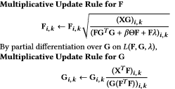
ALGORITHM / METHDOLOGY
Required : Spatial continuity matrix θ.
Weight of the spatial continuity regularization β.
Rank of the factorization r.
Input: A correlation graph X from which 4D tensor is obtained.
Output: F and M.
Solve the equation and set F for node discovery
While termination condition is not satisfied do
Update F and G

Slide 10

ALGORITHM / METHDOLOGY
Solve Equation and set M for edge discovery .
Rescale F and M
Return F and M.

Slide 11
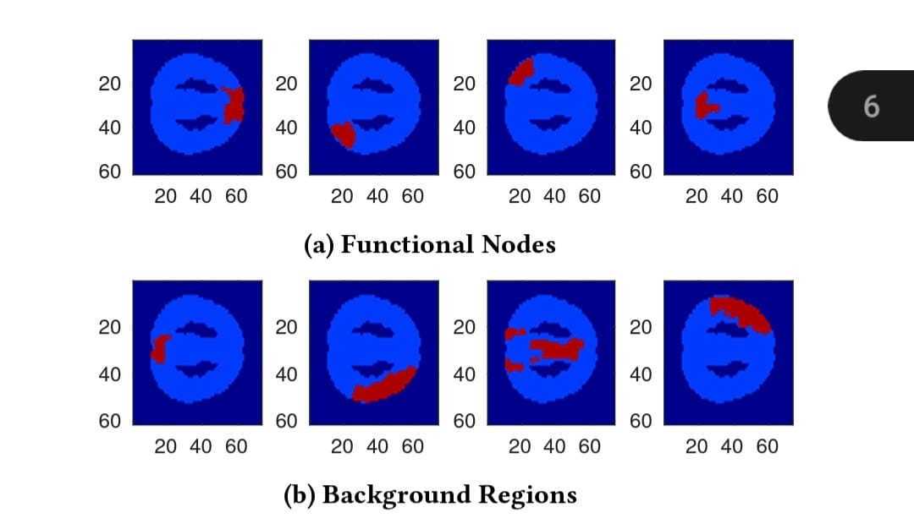
RESULTS
Synthetic region creation

Slide 12
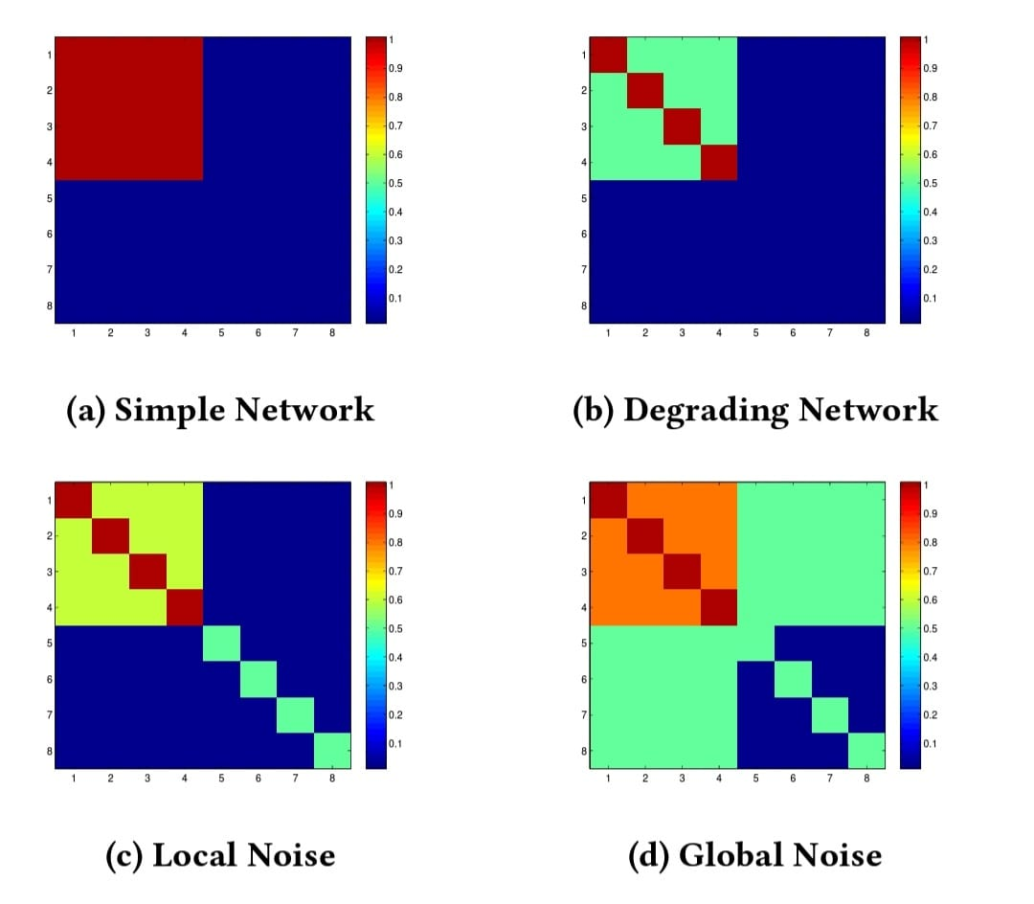
RESULTS
synthetic correlation matrices

Slide 13
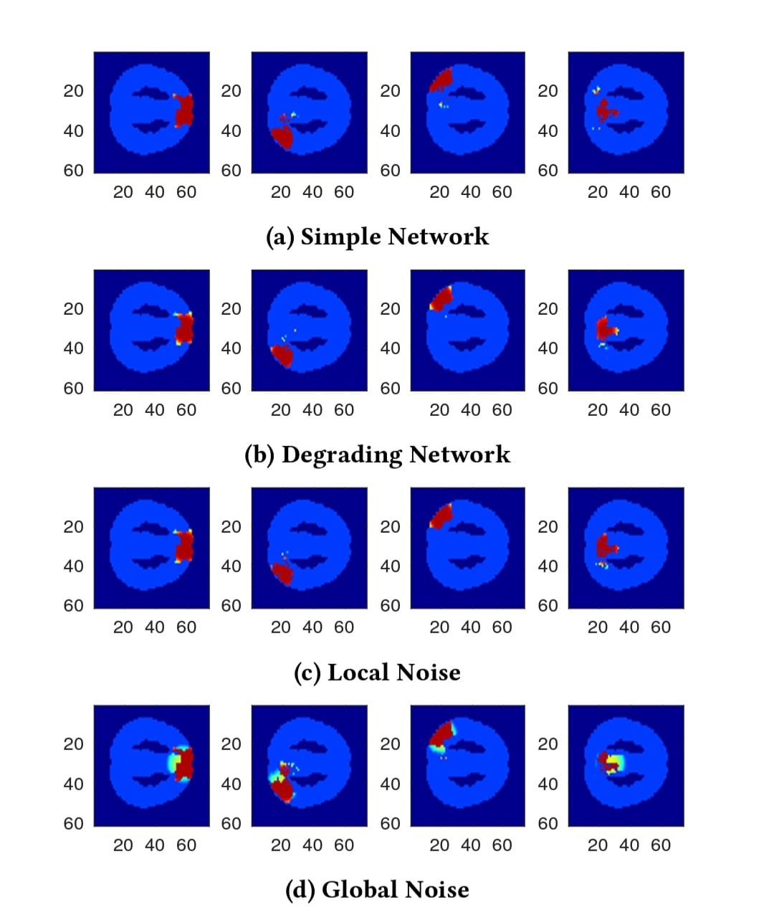
RESULTS
Recovered functional nodes from the example synthetic networks in synthetic settings

Slide 14
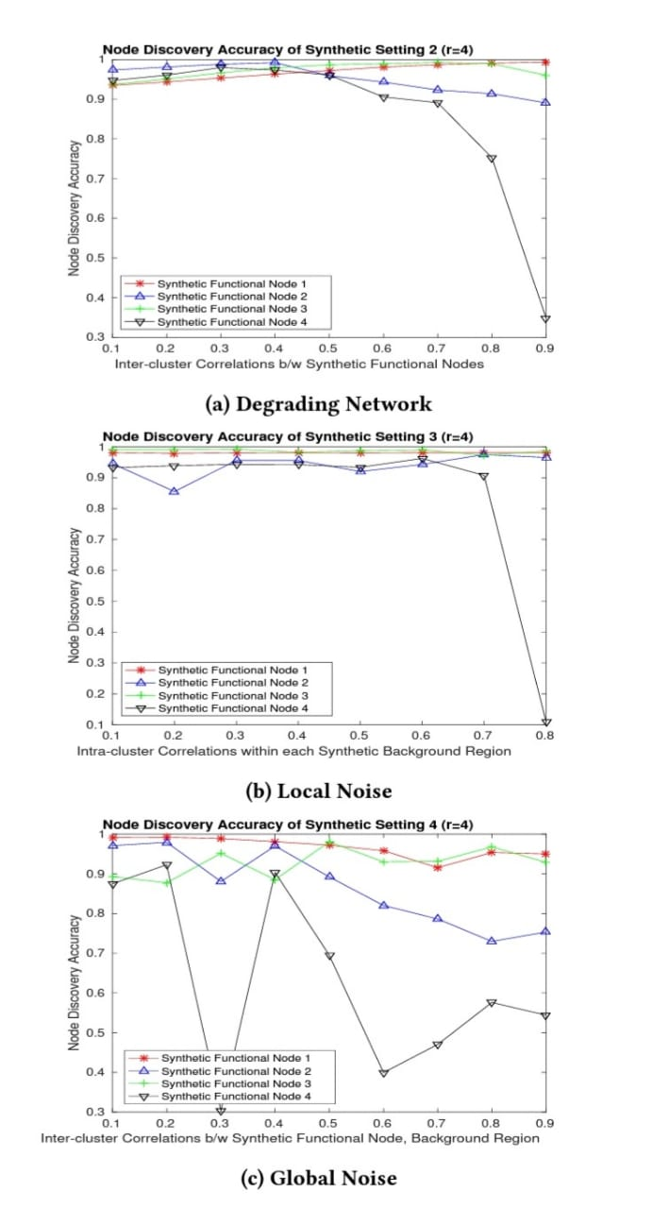
RESULTS
Node discovery accuracy measured for different synthetic networks.

Slide 15
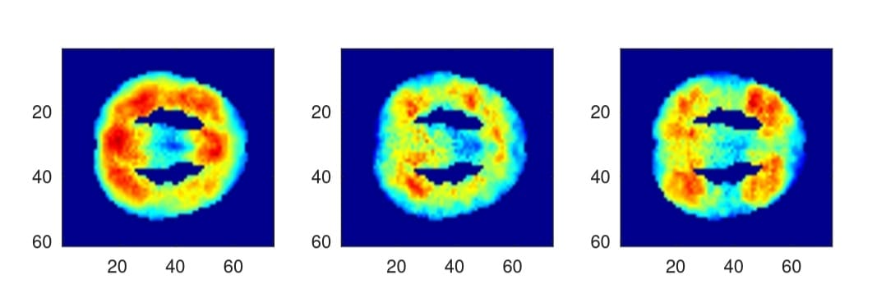
RESULTS
Average network discovery result of each cohort. Left: young normal, 40 fMRI scans. Middle: elderly normal, 19 fMRI scans. Right: elderly demented(Alzheimer affected), 21 fMRI scans.

Slide 16
APPLICATIONS
Discovering the new networks using the brain FMRI scan and classify the network in resting state healthy and Alzheimer affected individuals.
This model can be applied to other spatiotemporal from other domains such as astronomical, climate, geographical etc.

Slide 17
CONCLUSION
This paper pose the problem of unsupervised network discovery involving the discovery of regions with cohesive behavior (the nodes) and the relationship between those regions (the edges) from spatiotemporal data.
On synthetic data this method demonstrates robustness in the presence of different kind of background noise. For real data, It was not able to present all individuals result.
Future enhancement on this paper can be done by applying the method to task-driven FMRI scans and explore the other underlying network and new variations of the formulation like constraint M to be binary which helps to bring out useful insights.

Slide 18
REFERENCES
[1] Yu Zhao, Xiang Li, Heng Huang, Wei Zhang, Shijie Zhao, Milad Makkie, Mo Zhang, Quanzheng Li, Tianming Liu, Senior Member, “4D Modeling of fMRI Data via Spatio-Temporal Convolutional Neural Networks (ST-CNN)”, 2019 IEEE.
[2] Shuxue Tian, Hongguang Li , “ Brain Emotional Learning Network with applications”2019 IEEE
[3] Senzhang Wang, Jiannong Cao, Fellow, IEEE, Philip S. Yu, Fellow, “Deep Learning for Spatio-Temporal Data Mining: A Survey”,2019 IEEE.
[4] Maryam Gholami Doborjeh, Elisa Capecci and Nikola Kasabov Knowledge Engineering & Discovery Research Institute (KEDRI) Auckland University of Technology Auckland, New Zealand mgholami@aut.ac.nz, “Classification and Segmentation of fMRI SpatioTemporal Brain Data with a NeuCube Evolving Spiking Neural Network Model”,2014 IEEE.

